Slide 1
The Institution for Authority Research
authorityresearch.com
authorityresearch.com

Slide 2
"Trust in the Lord with all thine heart, and lean not unto thine own understanding.
In all thy ways acknowledge him, and he shall direct thy paths." Proverb. 3: 5-6
Two Paradigms
The Father’s authority: Patriarchal
The Children control: Heresiarchal
“CHANGE”

Slide 3
Diaprax
The Dialectic Process
and
Praxis

Slide 4
“Trust in the Lord with
all thine heart,”
“Trust in the Lord with
all thine heart,”
“and lean not unto
thine own understanding,”
lean unto thine own
understanding.
Proverbs 3:5
John 5:30; 12:49
Matt. 12:50; 7:21; 23:9
(Paradigms)
Genesis 3:1-6
Isaiah 55: 8, 9
“Consensus”
Preach Teach
Thesis
Chasten
Antithesis
Dialogue
Synthesis
Tradition
Transition
Transformation
Hebrews 12:5-11
Romans 7:14-25
Genesis 3:1-6
“Righteousness”
faith, belief, obedience,
and chastening
“Sensuousness”
doubt, question, disobey
and permissivness
“Reasoning”
seduction, deception,
and manipulation
Consciousness
Self-consciousness
“Reasoning”
Justification
Position
Knowing
“Is” “Not”
Patriarch
Husband/Father
Restrains
Relationship
Feelings
“ought”
Matriarch Wife/Mother
Liberates
Justification
Thinking
“Seem to”
Heresiarch
Facilitator of ‘change’/ Children
Common-ism

Slide 5
"Once the earthly family is discovered to be the secret of the holy family, the former must itself be annihilated [vernichtet] theoretically and practically."
(Karl Marx, Theses On Feuerbach #4)
What is Marxism?

Slide 6
"Once the earthly family is discovered to be the secret of the holy family, the former must itself be annihilated [vernichtet] theoretically and practically."
(Karl Marx, Theses On Feuerbach #4)

Slide 7
"God is conceived more directly after a parental and thus as a source of support and as a guiding and sometimes punishing authority."
(Theodor Adorno, The Authoritarian Personality)

Slide 8
"The life which he has given to the object sets itself against him as an alien and hostile force."
The authority which the child has given to the parents (by honoring their authority) sets itself against him as an alien and hostile force.
(Karl Marx, MEGA I/3)

Slide 9
"the conception of the ideal family situation for the child:
1. uncritical obedience to the father and elders,
2. pressures directed unilaterally from above to below,
3. inhibition of spontaneity, and
4. emphasis on conformity to externally imposed values,"
(Theodor Adorno, The Authoritarian Personality)

Slide 10
What does the “earthly family” and the “Holy family” have in common?
Hebrews 12:7-11
The father/Father has authority to:
give commands and rules to be obeyed and preach and teach facts and truth to be accepted as is, i.e. by faith.
bless (reward) those children who obey and do what is right (according to his/His standards).
chasten those children who disobey or do what is wrong, to encourage them to do what is right.
casts out those children who question his/His commands, rules, facts, and truth and challenge his/His authority to bless, chasten, and cast out.

Slide 11
"Authoritarian submission was conceived of as a very general attitude that would be evoked in relation to a variety of authority figures—parents, older people, leaders, supernatural power, and so forth."
(Theodor Adorno, The Authoritarian Personality)

Slide 12
"Authoritarian submission was conceived of as a very general attitude that would be evoked in relation to a variety of authority figures—parents, older people, leaders, supernatural power, and so forth."
(Theodor Adorno, The Authoritarian Personality)
If nationalism prevents globalism
and nationalism is the result of the traditional family,
then the traditional family must be negated
if globalism is to become a reality.

Slide 13
"We are proud that in his conduct of life man has become free from external authorities, which tell him what to do and what not to do."
(Erick Fromm, Escape from Freedom)

Slide 14
"The correct thing to do with authoritarians is to take them realistically for the bastards they are and then behave toward them as if they were bastards."
(Abraham Maslow, Maslow on Management)

Slide 15
"I have found whenever I ran across authoritarian students that the best thing for me to do was to break their backs immediately."
(Abraham Maslow, Maslow on Management)

Slide 16
"My children got in into conflict with my theory?"
"Who should teach whom? "
"I've been in continuous conflict over this Esalen-type, orgiastic, Dionysian-type education."
(Abraham Maslow, The Journals of Abraham Maslow)

Slide 17
"Once the earthly family is discovered to be the secret of the holy family, the former must itself be annihilated [vernichtet] theoretically and practically."
(Karl Marx, Theses On Feuerbach #4)
What is the
dialectic process?

Slide 18
"The child, contrary to appearance, is the absolute, the rationality of the relationship; he is what is enduring and everlasting, the totality which produces itself once again as such.“
[once ‘liberated’ from the father’s authority]
(George Hegel, System of Ethical Life)

Slide 19
What is the child’s nature?
To approach pleasure
and
to avoid pain.

Slide 20
"In the words of Thoreau: 'We need pray for no higher heaven than the pure senses can furnish, a purely sensuous life. Our present senses are but rudiments of what they are destined to become.'"
(Norman O. Brown, Life Against Death: The Psychoanalytical Meaning of History)

Slide 21
"In the words of Thoreau: 'We need pray for no higher heaven than the pure senses can furnish, a purely sensuous life. Our present senses are but rudiments of what they are destined to become.'"
(Norman O. Brown, Life Against Death: The Psychoanalytical Meaning of History)
“Sensuous Needs”
“Sense Perception”
“Sense Experience”
“Only proceeding from Nature.”
Karl Marx, MEGA I/3

Slide 22
DOPAMINE
HO
HO
C = C
H H
C─C─C─N
H H
H
C
=
=
C ─ C
H
Look
Aware
Acquire
ENVIRONMENT
BRAIN
Touch
Taste
Sight
Sound
Smell
Pleasurable
synaptic gap

Slide 23
All that is of the world: lust of the flesh and the eyes, and pride in controlling (augmenting) that which engenders pleasure. We are not in love with the gratifying objects of the world. We are in love with the dopamine they ‘liberate.’
A gratifying object in the environment stimulates a nerve ending.
5)
The child moves to acquire the object of gratification in the environment, to “control” it, for more dopamine ‘emancipation.’
1)
4)
The child looks for the gratifying object in the environment that stimulated dopamine ‘emancipation’ in the brain.
Dopamine is ‘liberated’ into the synaptic gap’s of the dendrites of the nervous system in the brain, making the child aware of, and desiring, the gratifying object in the environment.
Touch, taste, sight, smell, sound.
2)
3)
Dopamine is ‘emancipated’ into the synaptic gap between the nerve endings, engendering a “wanting” for the gratifying object in the environment.

Slide 24
All that is of the world: lust of the flesh and the eyes, and pride in controlling (augmenting) that which engenders pleasure. We are not in love with the gratifying objects of the world. We are in love with the dopamine they ‘liberate.’
A gratifying object in the environment stimulates a nerve ending.
The Father
Can not!
Must not!
Thou Shalt not!
5)
The child moves to acquire the object of gratification in the environment, to “control” it, for more dopamine ‘emancipation.’
1)
4)
The child looks for the gratifying object in the environment that stimulated dopamine ‘emancipation’ in the brain.
Dopamine is ‘liberated’ into the synaptic gap’s of the dendrites of the nervous system in the brain, making the child aware of, and desiring, the gratifying object in the environment.
Touch, taste, sight, smell, sound.
2)
3)
Dopamine is ‘emancipated’ into the synaptic gap between the nerve endings, engendering a “wanting” for the gratifying object in the environment.

Slide 25
All that is of the world: lust of the flesh and the eyes, and pride in controlling (augmenting) that which engenders pleasure. We are not in love with the gratifying objects of the world. We are in love with the dopamine they ‘liberate.’
The “child within.”
A gratifying object in the environment stimulates a nerve ending.
The Father
Can not!
Must not!
Thou Shalt not!
5)
The child moves to acquire the object of gratification in the environment, to “control” it, for more dopamine ‘emancipation.’
1)
4)
The child looks for the gratifying object in the environment that stimulated dopamine ‘emancipation’ in the brain.
Dopamine is ‘liberated’ into the synaptic gap’s of the dendrites of the nervous system in the brain, making the child aware of, and desiring, the gratifying object in the environment.
Touch, taste, sight, smell, sound.
2)
3)
Dopamine is ‘emancipated’ into the synaptic gap between the nerve endings, engendering a “wanting” for the gratifying object in the environment.
Love of pleasure and hate of restraint.

Slide 26
"For all that is in the world, the lust of the flesh, and the lust of the eyes, and the pride of life, is not of the Father, but is of the world." 1 John 2:16

Slide 28
The father – child conflict.
Child: Starts to go out to play with his friends (dopamine).
Father: Stops child at the door, saying “You ‘can not’ go out.”
Child: Asks “Why?” (To get the father into dialogue).
Father: The father responds with “Because I said so.” (stops dialogue)
“Is” – “Not” condition: (2 + 2 = 4 ≠ any other number)
The child can not get the father into dialogue so he dialogues
(‘reasons’) within himself (talks to his “self”) instead.
“I ought to be able to,” “Should be able to,” “Might be able to,” etc.
There is no father’s authority in dialogue, i.e. in the child’s “ought.”

Slide 29
Philosophy is :
The child dissatisfied with the way the world “is,”
thinking about about how it “ought” to be.

Slide 30
The role of a facilitator of ‘change’ is to:
create an environment of “oughtiness” (Maslow)
an “Open ended,” “Non-directed” environment (Rogers)
where the child can safely dialogue his opinion (share his “ought”) with other children, with all children coming to a consensus (to a feeling of “oneness”).
By putting dialectic ‘reasoning’ into social action, the children can ‘liberate’ themselves from their father’s authority, not only in their feelings, thoughts, and actions, but also in their relationship with one another, engendering “the tyranny of the masses,” where “the people” not only hate the father’s authority, but they ‘willingly’ fight against it as well, treating the father’s authority as not only being “irrational” but as being “irrelevant,” negating it, having no “guilty conscience” while doing so.
There is no “guilty conscience” in our “ought.”

Slide 31
The role of a facilitator of ‘change’ is to:
create an environment of “oughtiness” (Maslow)
an “Open ended,” “Non-directed” environment (Rogers)
where the children can safely dialogue their opinions with one another, to a consensus (to a feeling of “oneness”).
By putting dialectic ‘reasoning’ into social action the children can ‘liberate’ themselves from their father’s authority, not only in their feelings, thoughts, and actions, but also in their relationship with one another, engendering “the tyranny of the masses,” where “the people” not only hate the father’s authority, but they ‘willingly’ fight against it as well, treating the father’s authority as not only being “irrational” but as being “irrelevant” as well, negating it, having no “guilty conscience” while doing so.
The dialect process ‘liberties’ the Karl Marx in you.
It ‘justifies’ your love of pleasure and hate of parental/Godly restraint.

Slide 32
What is Psychology?

Slide 33
"'It is not really a decisive matter whether one has killed one's father or abstained from the deed,' if the function of the conflict and its consequences are the same."
(Sigmund Freud as quoted in Herbart Marcuse, Eros and Civilization: A philosophical inquiry into Freud)

Slide 34
"Freud noted that patricide and incest are part of man's deepest nature."
(Irvin Yalom, The Theory and Practice of Group Psychotherapy)
Husband
Wife
The desire of the wife's heart
is toward her husband.
The husband loves his wife
as Christ loves the church.

Slide 35
"Freud noted that patricide and incest are part of man's deepest nature."
(Irvin Yalom, The Theory and Practice of Group Psychotherapy)
Patricide
Perverse
Father
Mother
Husband
Wife
Incest
Children
Casts Out
Consensus

Slide 36
"Freud noted that patricide and incest are part of man's deepest nature."
(Irvin Yalom, The Theory and Practice of Group Psychotherapy)
Hate of restraint.
Love of pleasure.

Slide 37
"... the hatred against patriarchal suppression—a ‘barrier to incest,' ... the desire (for the sons) to return to the mother—culminates in the rebellion of the exiled sons, the collective killing and devouring of the father [patricide], and the establishment of the brother clan ["community, " socialism],"
(Herbart Marcuse, Eros and Civilization: a psychological inquiry into Freud)

Slide 38
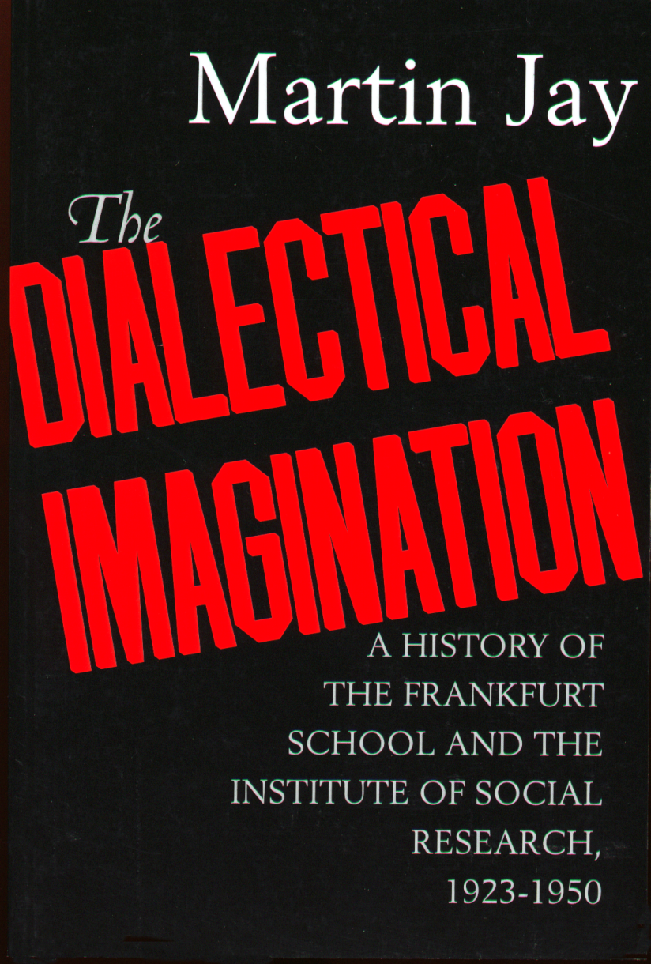
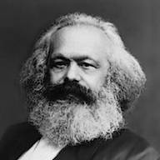
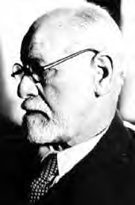
As the Frankfurt School wrestled with how to “reinvigorate Marx,”
they “found the missing link in Freud.”

Slide 39
"Freud speaks of religion as a 'substitute-gratification'—the Freudian analogue to the Marxian formula, 'opiate of the people.'"
(Norman O. Brown, Life Against Death: The Psychoanalytical Meaning of History)

Slide 40
"Marxian theory needs Freudian-type instinct theory to round it out. And of course, vice versa."
(Abraham Maslow, The Journals of Abraham Maslow)

Slide 41
"Freud, Hegel, ... are, like Marx, compelled to postulate external domination and its assertion by force in order to explain repression."
(Norman O. Brown, Life Against Death: The Psychoanalytical Meaning of History)

Slide 42
"The abolition of repression would only threaten patriarchal domination."
(Norman O. Brown, Life Against Death: The Psychoanalytical Meaning of History)

Slide 43
"Therefore the question confronting mankind is the abolition of repression – in traditional Christian language, the resurrection of the body."
"The resurrection of the body is a social project."
(Norman O. Brown, Life Against Death: The Psychoanalytical Meaning of History)

Slide 44
What is the dialectic process?
Exonerating the nature of the child over and therefore against the father’s/Father’s authority.
Placing the child’s opinion over and therefore against the father’s/Father’s preaching and teaching.

Slide 45
"Once the earthly family is discovered to be the secret of the holy family, the former must itself be annihilated [vernichtet] theoretically and practically."
(Karl Marx, Theses On Feuerbach #4)
Marxism is all about negating the father’s/Father’s authority in society. Using force to do so.
(theory and practice)

Slide 46
"Once the earthly family is discovered to be the secret of the holy family, the former must itself be annihilated [vernichtet] theoretically and practically."
(Karl Marx, Theses On Feuerbach #4)
How the Dialectic process works:
To negate the father’s/Father’s authority, i.e. his preaching and teaching of commands, rules, facts, and truth, you must become free to dialogue your opinion, i.e. your “feelings” and “thoughts” of the ‘moment’ with others to a consensus, i.e. to a “feeling” of “oneness,” i.e. “common-unity” with one another, where “relationship” is built upon common “self interests” instead of upon the father’s/Father’s commands, rules, facts, and truth.
While there is no ‘compromise in the Father’s authority, ‘compromise’ is necessary to initiate and sustain “community.”

Slide 47
"Once the earthly family is discovered to be the secret of the holy family, the former must itself be annihilated [vernichtet] theoretically and practically."
(Karl Marx, Theses On Feuerbach #4)
"Then both parties [through dialogue] recognize their rigidified position in relation to each other as the result of detachment and abstraction from their common life context. And in the latter, the dialogic relation of recognizing oneself in the other, they experience the common ground of their existence."
(Jürgen Habermas, The Idea of the Theory of Knowledge as Social Theory)

Slide 48
"Once the earthly family is discovered to be the secret of the holy family, the former must itself be annihilated [vernichtet] theoretically and practically."
(Karl Marx, Theses On Feuerbach #4)
"If ... man can ever be redeemed by freedom, then the ‘original sin' must be committed again: ‘We must again eat from the tree of knowledge ...."
Herbart Marcuse, Eros and Civilization: A philosophical inquiry into Freud

Slide 49
The Dialectic Formula
Thesis
Antithesis
Father’s Authority
Child’s Feelings
Preaching & Teaching:
rules, commands,
facts, & truth.
Approaching Pleasure & Avoiding Pain
Hebrews 12:5-11
Romans 7:14-25
Chastening engendering a “Guilty Conscience.”
Jesus Christ and His Father
Synthesis

Slide 50
"Once the earthly family is discovered to be the secret of the holy family, the former must itself be annihilated [vernichtet] theoretically and practically."
(Karl Marx, Theses On Feuerbach #4)
“Lawfulness without law,”
(law of the flesh without the law of God)
“Purposiveness without purpose.”
(Serving mankind rather than serving God)
Immanuel Kant, Critique of Pure Reason.

Slide 51
The Dialectic Formula
Thesis
Antithesis
Child’s Feelings
Father’s Authority
Approaching Pleasure & Avoiding Pain
Doing right and not wrong.
Dialoging of Opinions to a Consensus
Negate the father’s authority in the child’s feelings, thoughts, and actions and in his relationship with others.
Synthesis

Slide 52
"Once the earthly family is discovered to be the secret of the holy family, the former must itself be annihilated [vernichtet] theoretically and practically."
(Karl Marx, Theses On Feuerbach #4)
How a Soviet (the consensus process) works:
1) A diverse group of people (tolerant of deviancy),
2) Dialoging their opinions to a consensus,
3) Over social issues (crisis),
4) In a facilitated meeting,
5) To a pre-determined outcome—
Steps 1-5 above.
Guaranteeing that there is no father’s authority (no private property or business) influencing public policy, limiting the power of government.

Slide 53
"Once the earthly family is discovered to be the secret of the holy family, the former must itself be annihilated [vernichtet] theoretically and practically."
(Karl Marx, Theses On Feuerbach #4)
What affect does the
dialectic process have upon your life?

Slide 54
"On account of the absolute and natural oneness of the husband, the wife, and the child, ... the surplus is not the property of one of them ... all contracts regarding property or service and the like fall away ... the surplus, labour, and property are absolutely common to all, inherently and explicitly."
(George Hegel, System of Ethical Life)

Slide 55
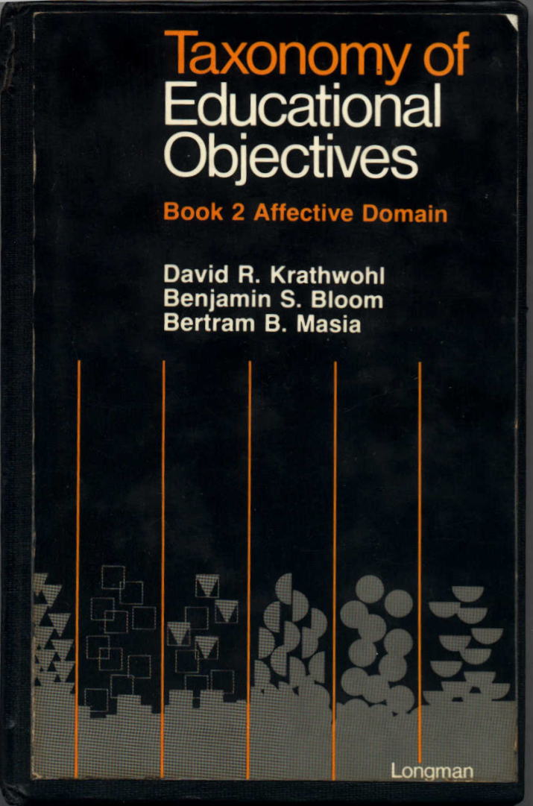
“Bloom’s Taxonomies”
“Marzano’s Taxonomies”
“Webb’s Taxonomies”

Slide 56
"There are many stores of the conflict and tension that these new practices are producing between parents and children."
(Taxonomy of Educational Objective: Book 2 Affective Domain)

Slide 57
"… a psychological classification system."
(Taxonomy of Educational Objective: Book 1 Cognitive Domain)

Slide 58
"…truth and knowledge are only relative and that there are no hard and fast truths which exist for all time and places."
(Taxonomy of Educational Objective: Book 1 Cognitive Domain)
"In the eyes of the dialectical philosophy, nothing is established for all time, nothing is absolute or sacred."
Karl Marx

Slide 59
"Weltanschauung."
(Taxonomy of Educational Objective: Book 2 Affective Domain)
Theodor Adorno, Erick Fromm

Slide 60
"In fact, a large part of what we call 'good teaching' is the teacher's ability to attain affective objectives through challenging the student's fixed beliefs and getting them to discuss issues."
(Taxonomy of Educational Objective: Book 2 Affective Domain)

Slide 61
"The affective domain is, in retrospect, a virtual ‘Pandora's Box.’
It is in this ‘box' that the most influential controls are to be found.
The affective domain contains the forces that determine the nature of an individual's life
and ultimately the life of an entire people."
(Taxonomy of Educational Objective: Book 2 Affective Domain)

Slide 62
"Kurt Lewin emphasized that the child takes on the characteristic behavior of the group in which he is placed. . . . he reflects the behavior patterns which are set by the adult leader of the group."
(Wilbur Brookover, A Sociology of Education)
Facilitator of
‘change’
Father’s authority
Child’s feelings

Slide 63
"The negative valence of a forbidden object which in itself attracts the child thus usually derives from an induced field of force of an adult."
(Kurt Lewin, A Dynamic Theory of Personality: Selected Papers)

Slide 64
"If this field of force loses its psychological existence for the child (e.g., if the adult goes away or loses his authority) the negative valence also disappears."
(Kurt Lewin, A Dynamic Theory of Personality: Selected Papers)

Slide 65
"Change in organization can be derived from the overlapping between play and barrier behavior."
(Kurt Lewin, Frustration and Regression)

Slide 66
"To be governed by two strong goals is equivalent to the existence of two conflicting controlling heads within the organism."
(Kurt Lewin, Frustration and Regression)

Slide 67
"This should lead to a decrease in degree of hierarchical organization."
(Kurt Lewin, Frustration and Regression)

Slide 68
"Also, a certain disorganization should result from the fact that the cognitive-motor system loses to some degree its character of a good medium because of these conflicting heads."
(Kurt Lewin, Frustration and Regression)

Slide 69
"It ceases to be in a state of near equilibrium; the forces under the control of one head have to counteract the forces of the other before they are effective."
(Kurt Lewin, Frustration and Regression)

Slide 70
"We know how to influence the ... behavior of individuals by setting up conditions which provide satisfaction for needs of which they are unconscious, but which we have been able to determine."
(Carl Rogers, on becoming a person: A Therapist View of Psychotherapy)

Slide 71
"We can choose to use our growing knowledge to enslave people in ways never dreamed of before, depersonalizing them, controlling them by means so carefully selected that they will perhaps never be aware of their loss of personhood."
(Carl Rogers, on becoming a person: A Therapist View of Psychotherapy)

Slide 72
"If we have the power or authority to establish the necessary conditions, the predicted behaviors will follow."
(Carl Rogers, on becoming a person: A Therapist View of Psychotherapy)

Slide 73
"By a careful design, we control not the final behavior, but the inclination to behavior–the motives, the desires, the wished. The curious thing is that in that case the question of freedom never arises. " "They are doing what they want to do, not what they are forced to do."
(Carl Rogers, on becoming a person: A Therapist View of Psychotherapy)

Slide 74
“Trust in the Lord with
all thine heart,”
“Trust in the Lord with
all thine heart,”
“and lean not unto
thine own understanding,”
lean unto thine own
understanding.
Proverbs 3:5
John 5:30; 12:49
Matt. 12:50; 7:21; 23:9
(Paradigms)
Genesis 3:1-6
Isaiah 55: 8, 9
“Consensus”
Preach Teach
Thesis
Chasten
Antithesis
Dialogue
Synthesis
Tradition
Transition
Transformation
Hebrews 12:5-11
Romans 7:14-25
Genesis 3:1-6
“Righteousness”
faith, belief, obedience,
and chastening
“Sensuousness”
doubt, question, disobey
and permissivness
“Reasoning”
seduction, deception,
and manipulation
Consciousness
Self-consciousness
“Reasoning”
Justification
Position
Knowing
“Is” “Not”
Patriarch
Husband/Father
Restrains
Relationship
Feelings
“ought”
Matriarch Wife/Mother
Liberates
Justification
Thinking
“Seem to”
Heresiarch
Facilitator of ‘change’/ Children
Common-ism

Slide 75
"Bypassing the traditional channels of top-down decision making, our objective centers upon .... transform public opinion into an effective instrument of global politics."
(Ervin Laszlo, A Strategy for the Future: The Systems Approach to World Order)

Slide 76
"Individual values must be measured by their contribution to common interests and ultimately to world interests.... transforming public consensus into one favorable to the emergence of a stable and humanistic world order."
(Ervin Laszlo, A Strategy for the Future: The Systems Approach to World Order)

Slide 77
"Consensus is both a personal and a political step. It is a precondition of all future steps..."
(Ervin Laszlo, A Strategy for the Future: The Systems Approach to World Order)

Slide 78
“Trust in the Lord with
all thine heart,”
“Trust in the Lord with
all thine heart,”
“and lean not unto
thine own understanding,”
lean unto thine own
understanding.
Proverbs 3:5
John 5:30; 12:49
Matt. 12:50; 7:21; 23:9
(Paradigms)
Genesis 3:1-6
Isaiah 55: 8, 9
“Consensus”
Preach Teach
Thesis
Chasten
Antithesis
Dialogue
Synthesis
Tradition
Transition
Transformation
Hebrews 12:5-11
Romans 7:14-25
Genesis 3:1-6
“Righteousness”
faith, belief, obedience,
and chastening
“Sensuousness”
doubt, question, disobey
and permissivness
“Reasoning”
seduction, deception,
and manipulation
Consciousness
Self-consciousness
“Reasoning”
Justification
Position
Knowing
“Is” “Not”
Patriarch
Husband/Father
Restrains
Relationship
Feelings
“ought”
Matriarch Wife/Mother
Liberates
Justification
Thinking
“Seem to”
Heresiarch
Facilitator of ‘change’/ Children
Common-ism

Slide 79
Hebrews 12:5-11

Slide 80
"And ye have forgotten the exhortation which speaketh unto you as unto children,
My son, despise not thou the chastening of the Lord, nor faint when thou art rebuked of him:"

Slide 81
"For whom the Lord loveth he chasteneth, and scourgeth every son whom he receiveth."

Slide 82
"If ye endure chastening, God dealeth with you as with sons; for what son is he whom the father chasteneth not?"

Slide 83
"But if ye be without chastisement, whereof all are partakers, then are ye bastards, and not sons."

Slide 84
"Furthermore we have had fathers of our flesh which corrected us, and we gave them reverence: shall we not much rather be in subjection unto the Father of spirits, and live?"

Slide 85
"For they verily for a few days chastened us after their own pleasure; but he for our profit, that we might be partakers of his holiness."

Slide 86
"Now no chastening for the present seemeth to be joyous, but grievous: nevertheless afterward it yieldeth the peaceable fruit of righteousness unto them which are exercised thereby."

Slide 87
Romans 7:14-25

Slide 88
"For we know that the law is spiritual: but I am carnal, sold under sin. For that which I do I allow not: for what I would, that do I not; but what I hate, that do I. If then I do that which I would not, I consent unto the law that it is good. Now then it is no more I that do it, but sin that dwelleth in me.

Slide 89
For I know that in me (that is, in my flesh,) dwelleth no good thing: for to will is present with me; but how to perform that which is good I find not. For the good that I would I do not: but the evil which I would not, that I do. Now if I do that I would not, it is no more I that do it, but sin that dwelleth in me.

Slide 90
I find then a law, that, when I would do good, evil is present with me. For I delight in the law of God after the inward man: But I see another law in my members, warring against the law of my mind, and bringing me into captivity to the law of sin which is in my members.

Slide 91
O wretched man that I am! who shall deliver me from the body of this death? I thank God through Jesus Christ our Lord. So then with the mind I myself serve the law of God; but with the flesh the law of sin."

Slide 92
The gospel message is about the Son’s obedience to His Father. It is about the Father and His Son.
"… bringing into captivity every thought to the obedience of Christ;" 2 Corinthians 10:7
"and truly our fellowship is with the Father, and with his Son Jesus Christ." 1 John 3:

Slide 93
"I can of mine own self do nothing: as I hear, I judge: and my judgment is just; because I seek not mine own will, but the will of the Father which hath sent me." John 5:30

Slide 94
"For I have not spoken of myself; but the Father who sent me, he gave me commandment what I should say, and what I should speak." John 12:49

Slide 95
"Jesus saith unto him, I am the way, the truth, and the life: no man cometh unto the Father, but by me." John 14:6

Slide 96
"For whosoever shall do the will of my Father which is in heaven, the same is my brother, and sister, and mother." Matthew 12:50

Slide 97
"And call no man your father upon the earth: for one is your Father, which is in heaven." Matthew 23:9

Slide 98
"Not every one that saith unto me, Lord, Lord, shall enter into the kingdom of heaven; but he that doeth the will of my Father which is in heaven." Matthew 7:21

Slide 99
"Whosoever therefore shall confess me before men, him will I confess also before my Father which is in heaven."
Matthew 10:32

Slide 100
"But whosoever shall deny me before men, him will I also deny before my Father which is in heaven."
Matthew 10:33

Slide 101
Genesis 3:1-6

Slide 102
Now the serpent was more subtle than any beast of the field which the LORD God had made. And he said unto the woman, Yea, hath God said, Ye shall not eat of every tree of the garden?

Slide 103
And the woman said unto the serpent, We may eat of the fruit of the trees of the garden: But of the fruit of the tree which is in the midst of the garden, God hath said, Ye shall not eat of it, neither shall ye touch it, lest ye die.

Slide 104
And the serpent said unto the woman, Ye shall not surely die: For God doth know that in the day ye eat thereof, then your eyes shall be opened, and ye shall be as gods, knowing good and evil.

Slide 105
And when the woman saw that the tree was good for food, and that it was pleasant to the eyes, and a tree to be desired to make one wise, she took of the fruit thereof, and did eat, and gave also unto her husband with her; and he did eat.

Slide 106
Jeremiah 17:9

Slide 107
The heart is deceitful above all things, and desperately wicked: who can know it?

Slide 108
Matthew 16:15

Slide 109
Ye are they which justify yourselves before men; but God knoweth your hearts: for that which is highly esteemed among men is abomination in the sight of God.

Slide 110
Jeremiah 17:5, 7

Slide 111
Thus saith the LORD; Cursed be the man that trusteth in man, and maketh flesh his arm, and whose heart departeth from the LORD.
Blessed is the man that trusteth in the LORD, and whose hope the LORD is.

Slide 112
Psalms 118:8

Slide 113
It is better to trust in the LORD than to put confidence in man.

Slide 114
Proverbs 16:5, 6

Slide 115
Every one that is proud in heart is an abomination to the LORD: though hand join in hand, he shall not be unpunished.
By mercy and truth iniquity is purged: and by the fear of the LORD men depart from evil.

Slide 116
Jeremiah 10:23

Slide 117
O LORD, I know that the way of man is not in himself: it is not in man that walketh to direct his steps.

Slide 118
For all that is in the world,
the lust of the flesh,
and the lust of the eyes,
and the pride of life,
is not of the Father,
but is of the world.
1 John 2:16

